Slide 1
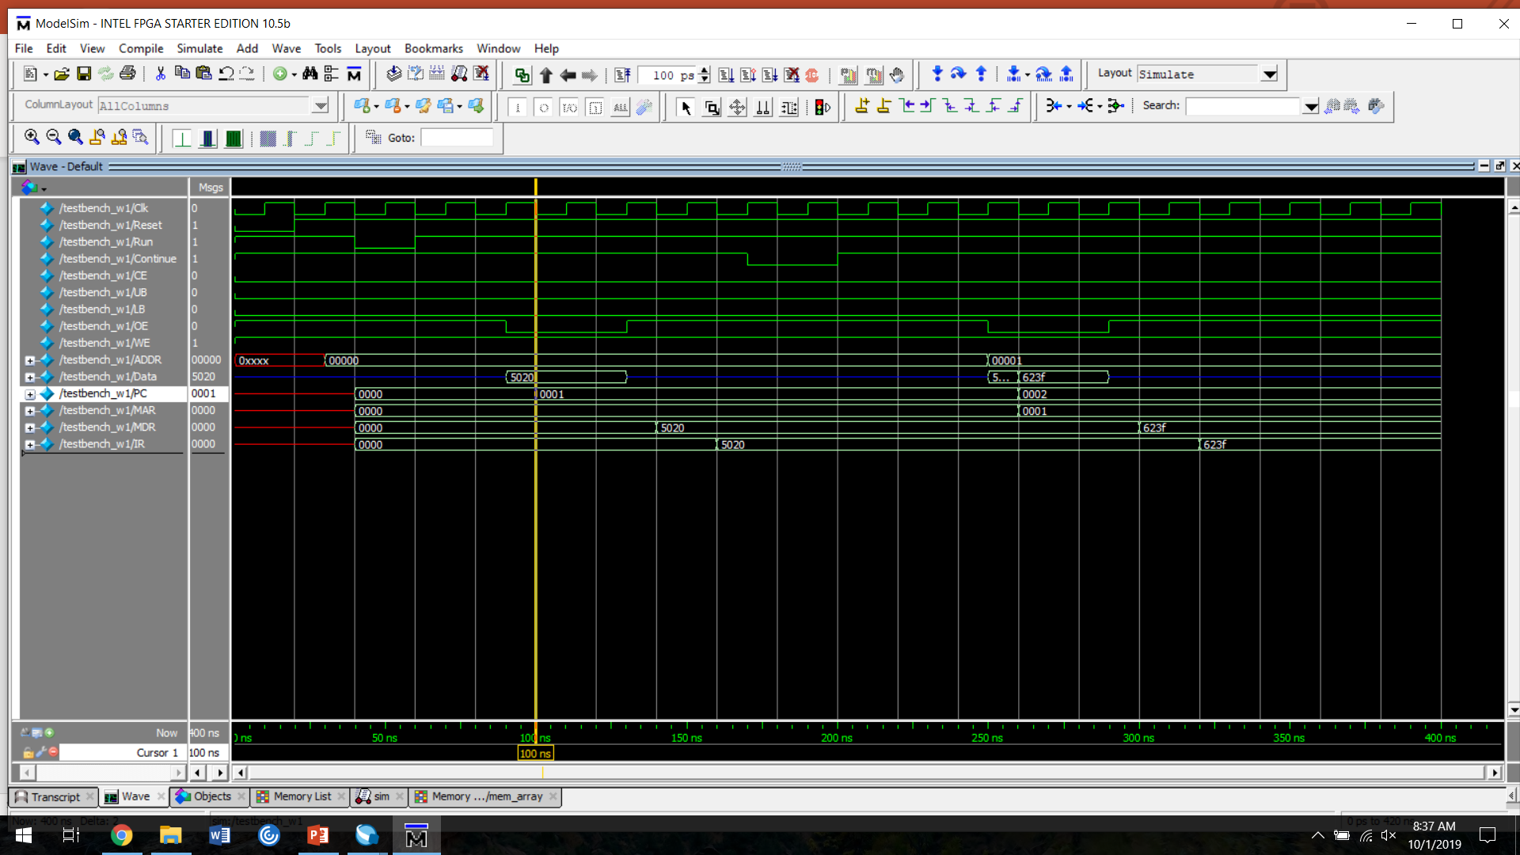
A B C D E F
A: MAR <- PC (16’h0000), PC <- PC+1 (16’h0001)
B: MDR <- M[MAR] (16’h5020)
C: IR <- MDR (16’h5020)
D: MAR <- PC (16’h0001), PC <- PC+1 (16’h0002)
E: MDR <- M[MAR] (16’h623F)
F: IR <- MDR (16’h623F)

